Slide 1


AML PROJECT DELIVERABLE 2
GROUP 2
CREDIT SCORE CLASSIFICATION
GOKUL NATESAN, MADHULIKA BALAKUMAR, SHUMAIL SAJJAD, YASH DANGE
CONTENT
01
INITIAL DATA EXPLORATION
02
CLEANING AND SAMPLING
03
INSIGHTS FROM DATA EXPLORATION
04
MACHINE LEARNING TECHNIQUES PROPOSED

Slide 2

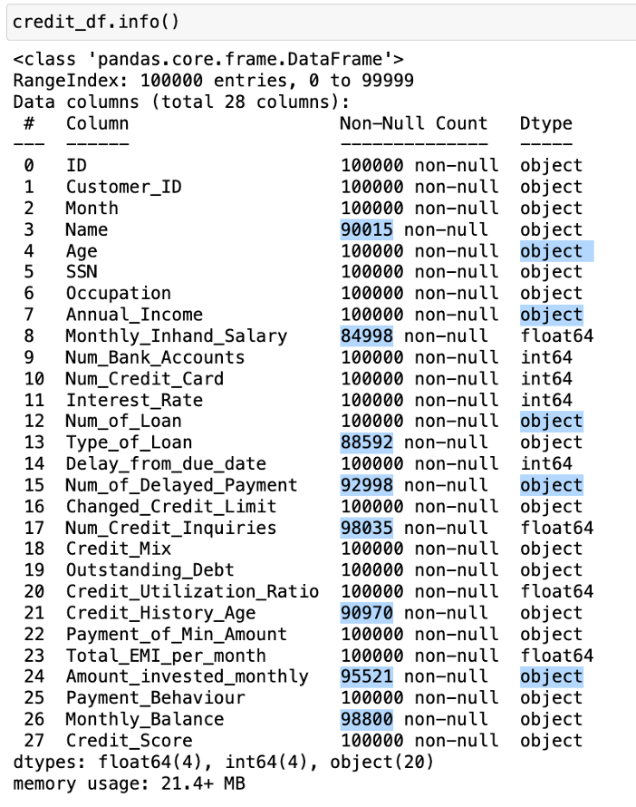
INITIAL DATA EXPLORATION
At a glance:
By simply taking a look at some basic summary information about the data, we can identify various issues that need to be addressed about the data, before it is ready to be trained using a model.
NUMBER OF ROWS: 100,000
NUMBER OF COLUMNS: 28
TARGET COLUMN: CREDIT SCORE
Main Issues:
Missing Values,Incorrect Datatypes, Outliers, Frequent occurance of ‘_’

Slide 3
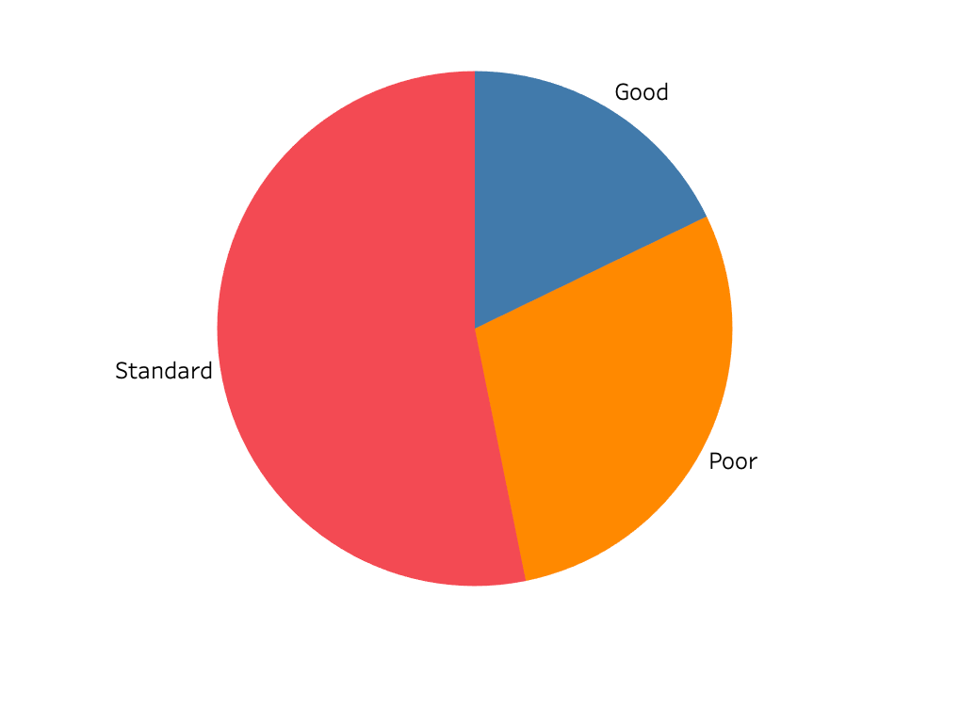
CLASS BALANCE: CREDIT SCORE
As shown in the figure, there are three possible classes for the target Column, viz. Standard, Poor, and Good. It can be seen that a majority of the class values are Standard, and Good or Poor labels are comparatively less. Since there are relatively good number of representations of each class interval, we can say the dataset is balanced.
Note: Since we have three classes in the target column, we will be doing either of ‘One vs One’ or ‘One vs Many’ approach while model training.

Slide 4

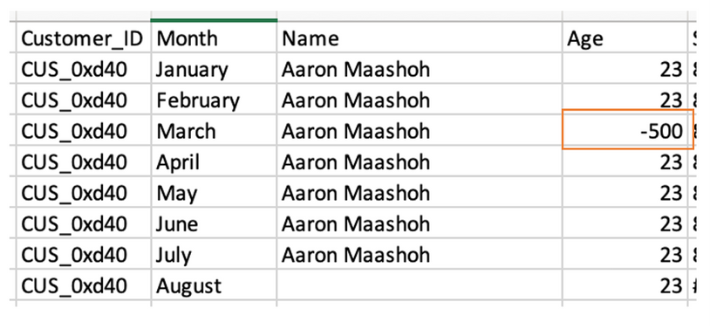
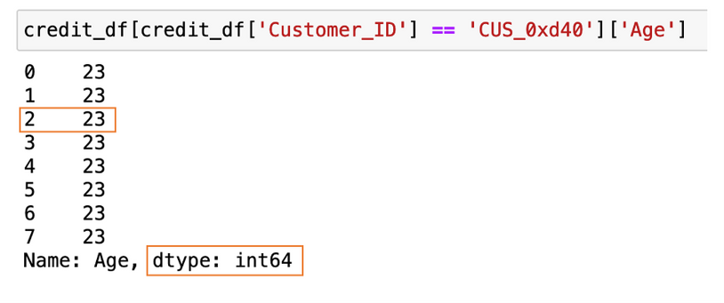
2. CLEANING AND SAMPLING
Age Column
Upon a brief observation of the data, we notice that there are misplaced underscores ‘_’ occasionally, the datatype is ‘object’ and some absurdly high values of age (5000) are present. Hence, we will fix this by
1. Eliminating the underscore
2. Converting the datatype to integer
3. Replacing ‘abnormal’ age values (here assumed to be under 10 and over 70) by corresponding age values of other columns with same customer ID and a ‘normal’ age value.
Before
After

Slide 5
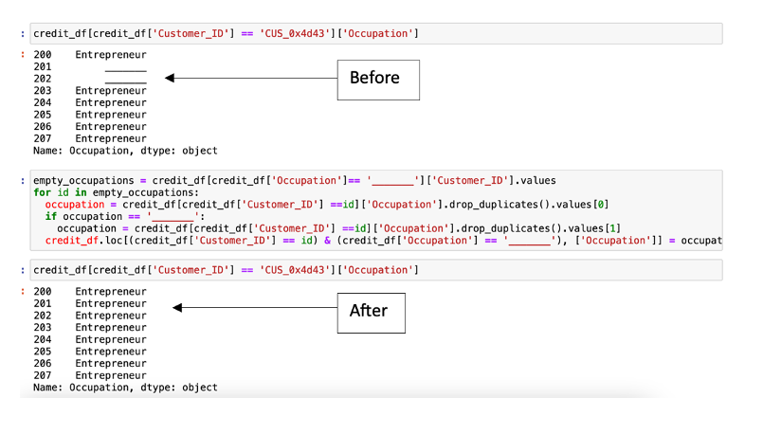
OCCUPATION COLUMN
Similar to previous techniques, we can simply replace occupation of '______' with the correct occupation of the applicant by looking up the corresponding customer_id
Important thing to note here is that: even though all seemed fine about the occupation column in the initial data.info part (no missing values, datatype was categorical as expected), there were certain issues with the data. Unlike the Name column which couldn’t have any influence on our target column, the occupation might be an important feature and thereby needs to be cleaned properly. This goes to show that data cleaning should be done carefully and scrupulously.

Slide 6
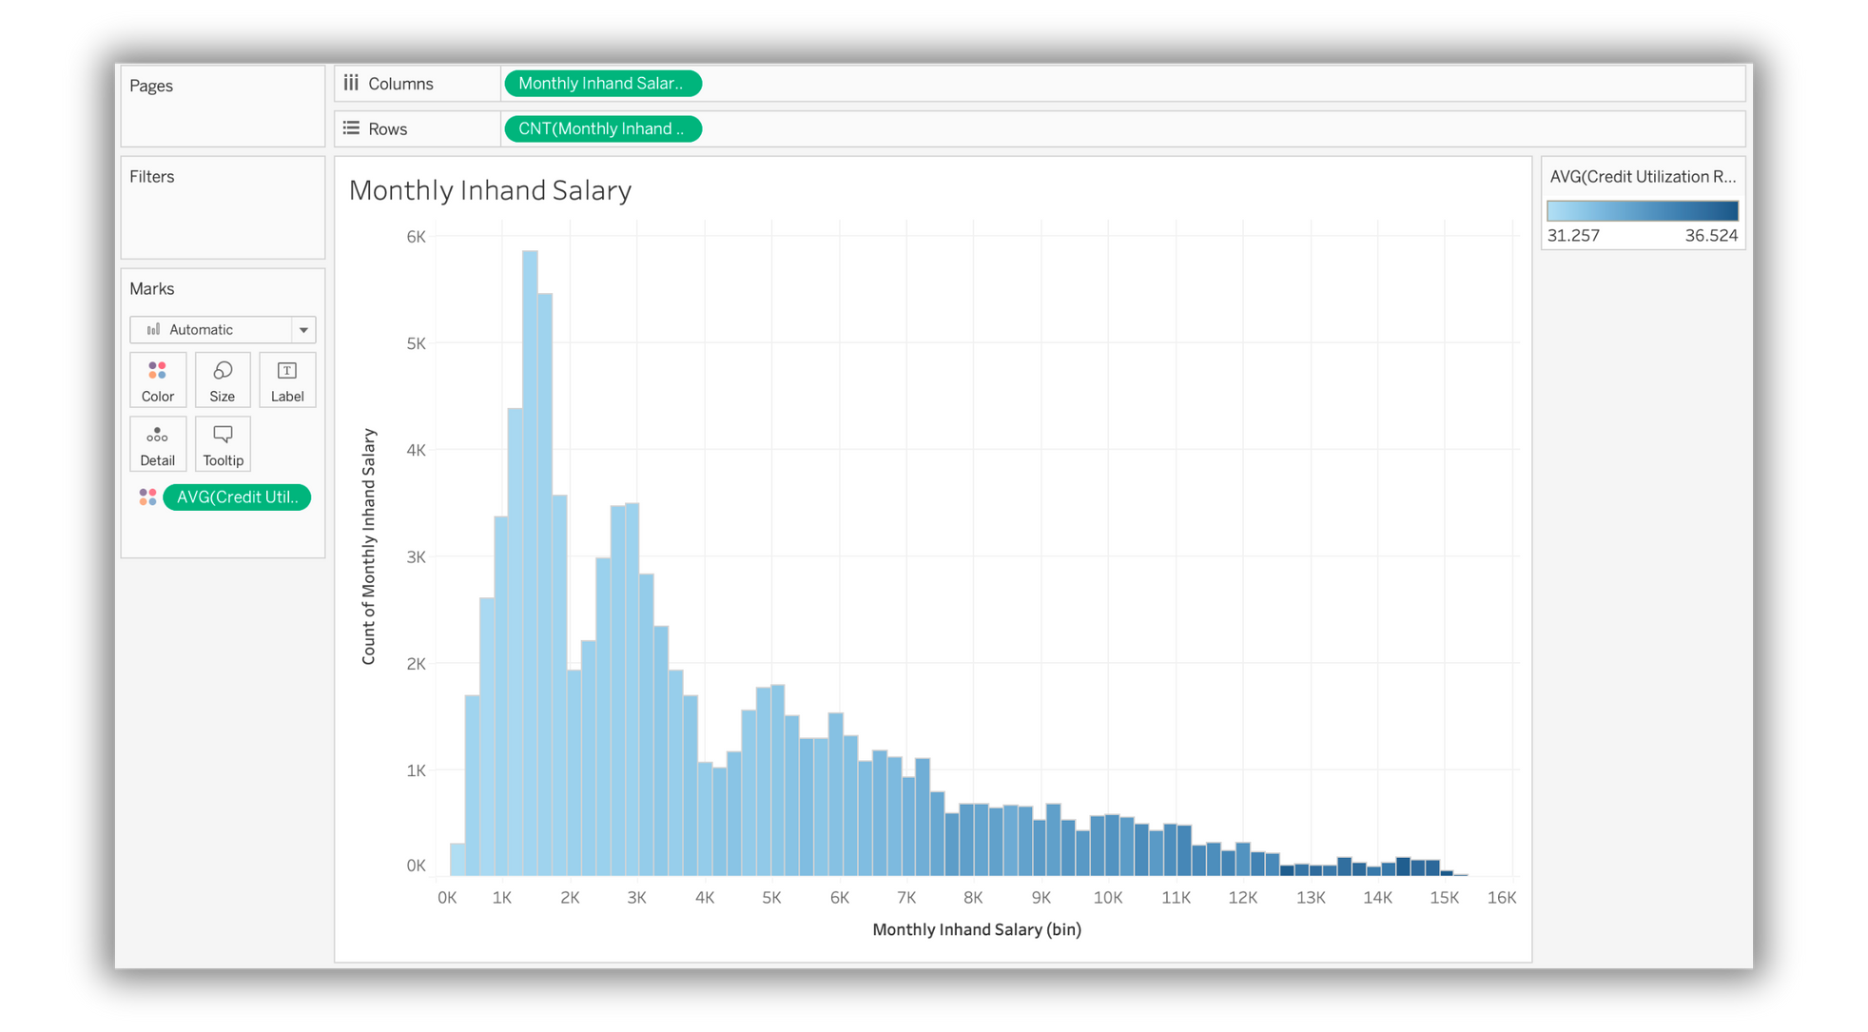
3. INSIGHTS FROM DATA EXPLORATION
In this section, we will try to understand dependance or general trend of individual columns and the target column, and also check how these columns are correlated with each other.

Slide 7
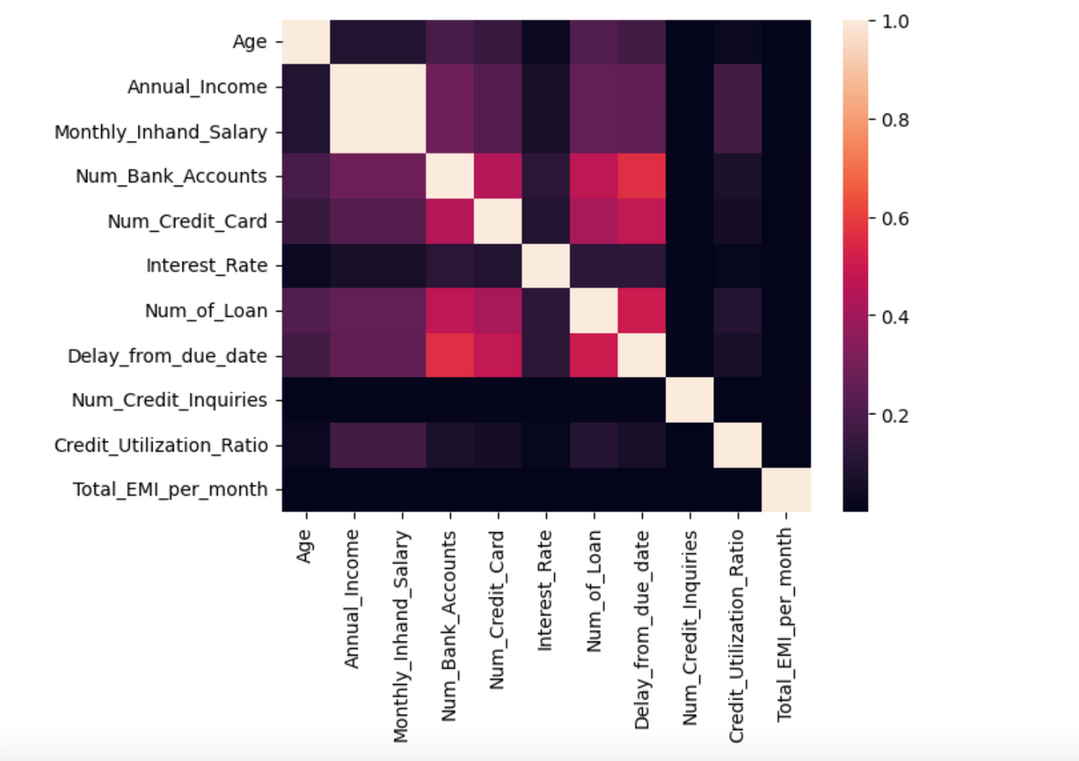
In the first graph, we plotted the frequency plot of ‘monthly in hand’ salaries of the people in the dataset. We have added the average credit utilisation ratio (in %) as a colour attribute. We can see that the data is skewed towards the left, suggesting that most people make about ~10K a month or less. People with higher income also seem to have a higher utilisation ratio of their credit line.
In this correlation plot, we can see how the independent variables are associated with each other.
As expected, Annual Income and Monthly inhand salary are almost perfectly positively correlated.
Credit Utilization Ratio is also stronly correlated with the income value.
Number of loans taken, Number of credit cards and number of bank accounts are also correlated, which is no surprise since having multiple loans at the same bank is unlikely.

Slide 8
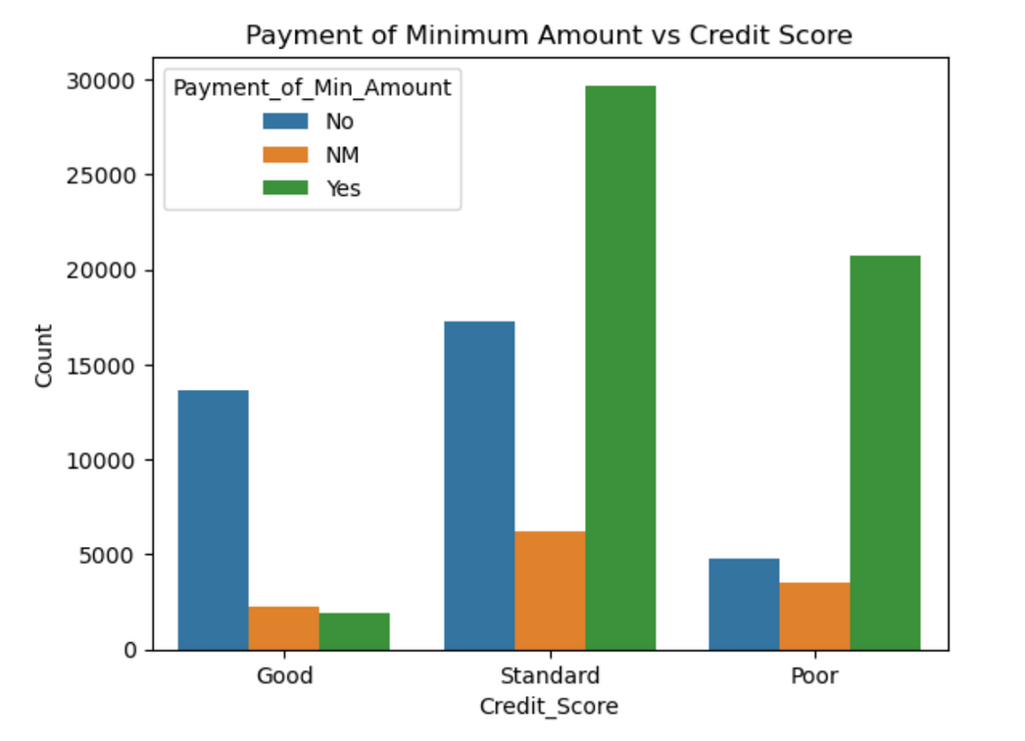
Here, we have seen the distribution of people who only paid the minimum amount due in each class of the target column. As seen, in the ‘Good’ class, majority of people did not pay just the minimum amount due, but the full amount. In the poor class, this number is significantly higher and most people only paid the minimum amount. For standard, again, almost twice as many people only paid the minimum amount than the ones who paid potentially more than that. This goes to show that it is preferred to pay the entire amount for a good score rating, but it is not the only matric that matters.

Slide 9
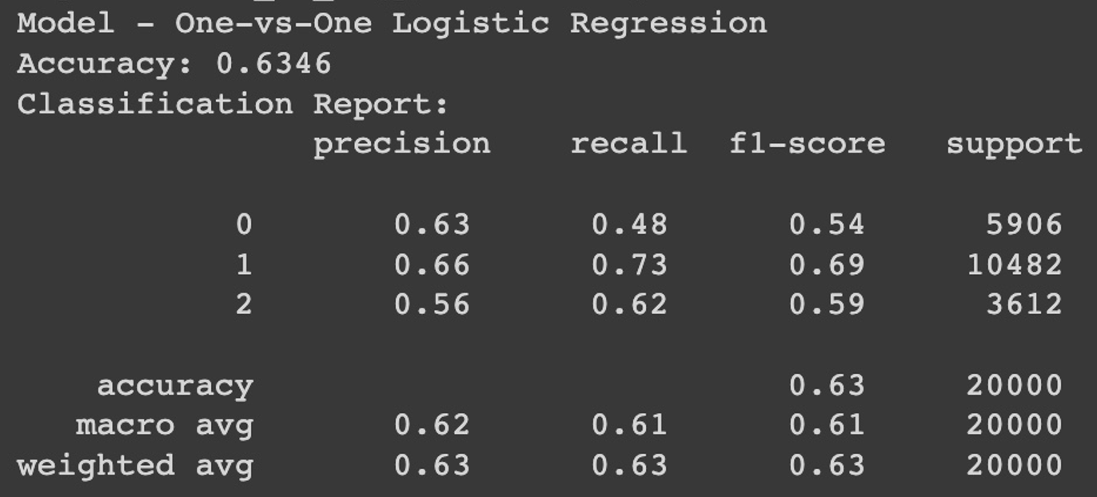
4. MACHINE LEARNING TECHNIQUES
Since our dataset had multiple entries for each customer ID and almost the same demographic and income information across entries for customers, we used a custom splitter to group data by ‘Customer_ID’ and did a stratified split based on the target class.
We have applied a standard scaler to the dataset as models like Logistic Regression and SVM require this preprocessing step
Multiclass One-vs-One Logistic Regression model with default parameters:

Slide 10
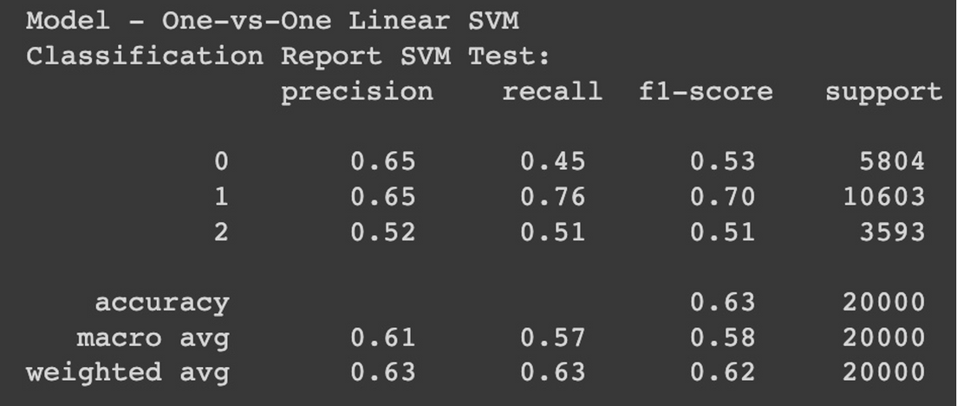
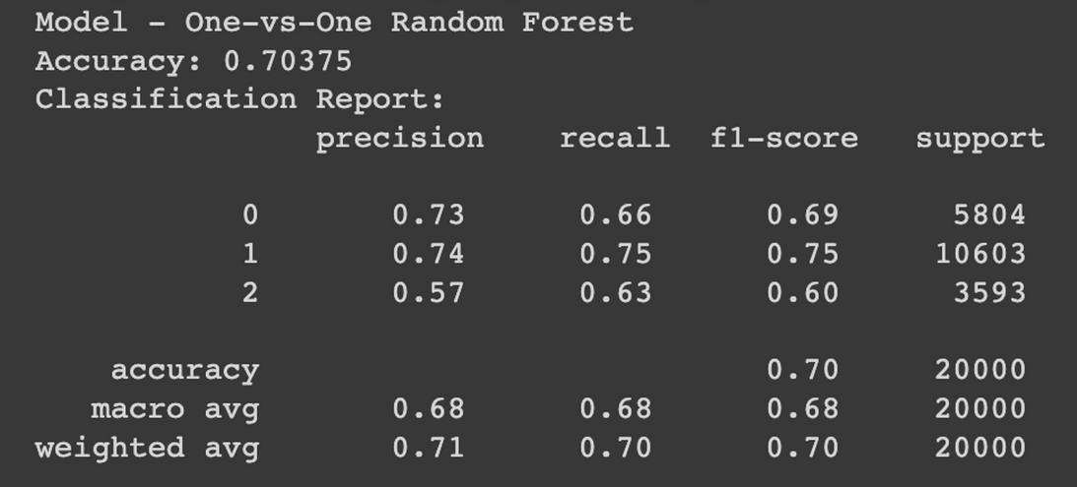
Multiclass One-vs-One SVM Primal model:
Multiclass One-vs-One SVM Random Forest model:

